Slide 1
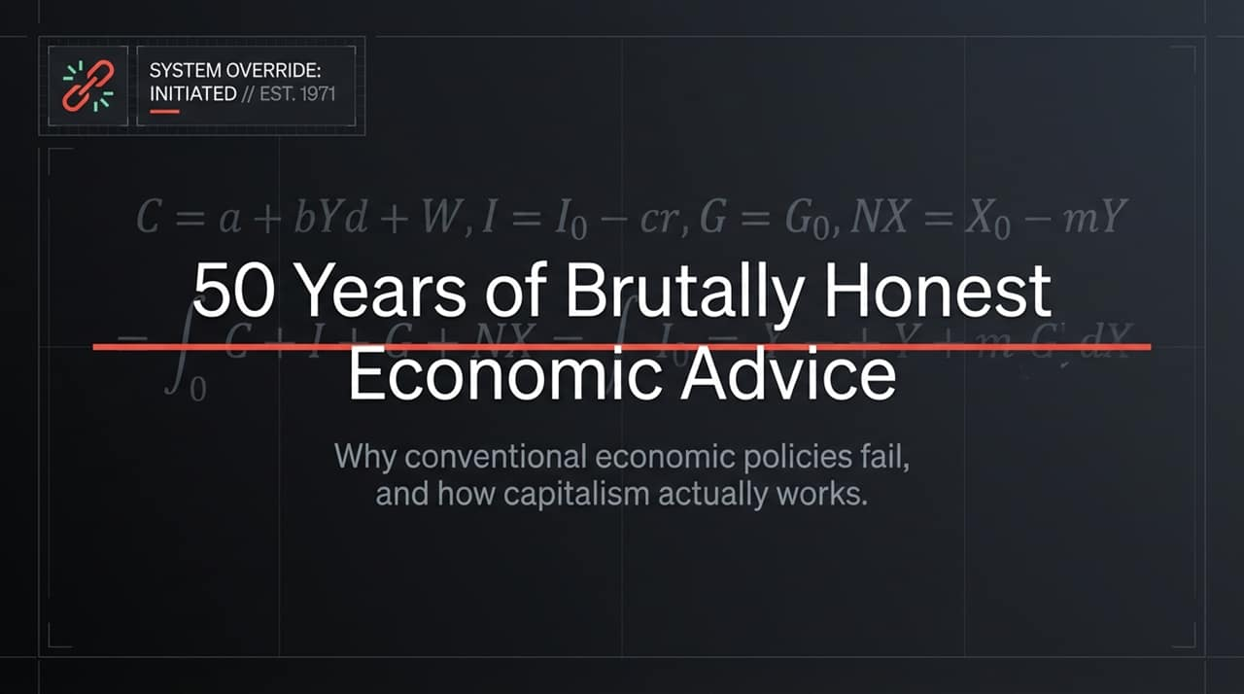
Notes:
Welcome, everyone. Today we are taking a look under the hood of modern economic policy and theory in a session titled System Override: 50 Years of Brutally Honest Economic Advice.
For decades, students, policymakers, and financial analysts have been taught macroeconomic models packed with elegant equations—like standard Keynesian consumption functions, interest rate equations, and net export formulas. Yet, despite these hyper-mathematical models, mainstream economics consistently fails to predict major financial crises, ignores energy boundaries, and misunderstands how money is actually created.
In this talk, we will break down why conventional economic models fail in the real world. We will systematically debunk the core myths of mainstream economics and replace them with an evolutionary, complexity-based understanding of real-world capitalism.
https://www.youtube.com/watch?v=M1odc6itzyk

Slide 2
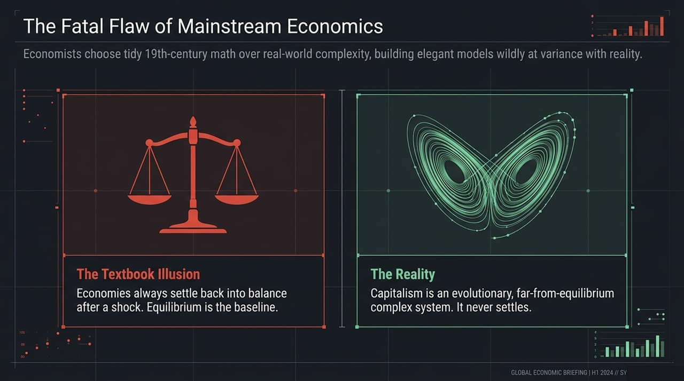
Notes:
Let's start at the root: The Fatal Flaw of Mainstream Economics. Mainstream economic theory was built in the 19th century by borrow-and-adapting equilibrium math from classical physics.
On the left, you see The Textbook Illusion. Standard models assume that an economy is naturally self-balancing. When hit by an external shock—like a supply chain disruption or a oil crisis—the economy is assumed to smoothly settle back into a stable state of equilibrium.
On the right, you see The Reality. Real-world capitalism is not a mechanical scale; it is a complex, non-linear, evolutionary system operating far from equilibrium. Much like a Lorenz strange attractor in chaos theory, capitalism is dynamic and constantly shifting. It never 'settles'. Trying to manage a complex, evolving market with static equilibrium models is like trying to navigate a turbulent storm using a map of a still lake.

Slide 3
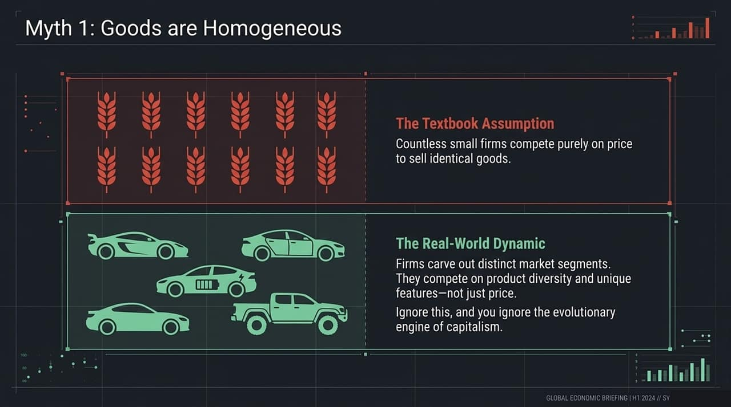
Notes:
Myth Number One in standard textbooks is the assumption that Goods are Homogeneous.
The textbook assumption assumes that markets consist of countless tiny firms competing purely on price to sell identical products—think of identical bundles of wheat. In this fantasy world, no single firm has market power, and product variation doesn't exist.
But look at real-world dynamics on the right. Real companies—whether in automotive, tech, or consumer goods—don't compete by selling identical commodities on price alone. They carve out distinct niches, invest heavily in R&D, and compete on product features, brand identity, and technological innovation.
Differentiation and diversity are the true evolutionary drivers of capitalism. If an economic model assumes all goods are homogeneous, it ignores the engine of innovation itself.

Slide 4
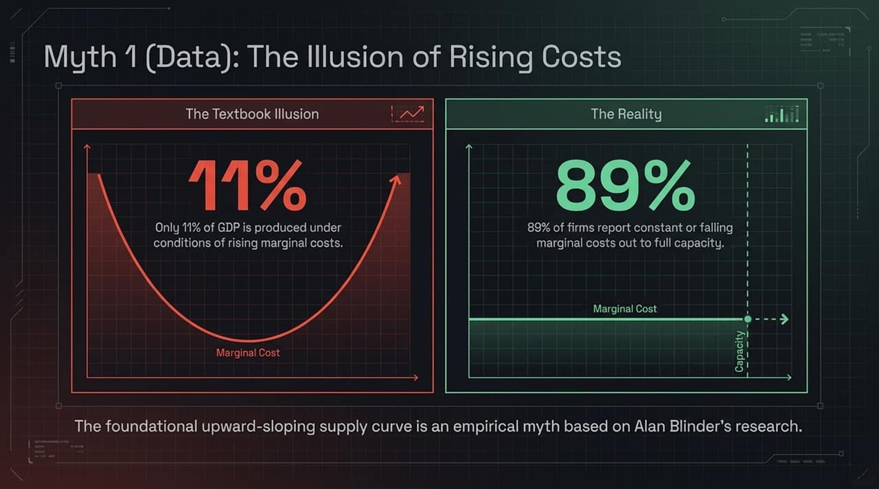
Notes:
Let's look at the data behind cost structures. Every standard microeconomics course teaches the famous U-shaped marginal cost curve. They claim that as a firm expands output, costs eventually rise, creating an upward-sloping supply curve.
But when renowned economist Alan Blinder surveyed real-world business executives, the empirical findings shattered this textbook rule:
Only 11% of GDP is produced under conditions of rising marginal costs.
A staggering 89% of firms reported that their marginal costs are either constant or falling all the way up to full operating capacity.
The foundational upward-sloping supply curve taught in every intro economics class is an empirical myth. In real industrial production, economies of scale dominate up to capacity.

Slide 5
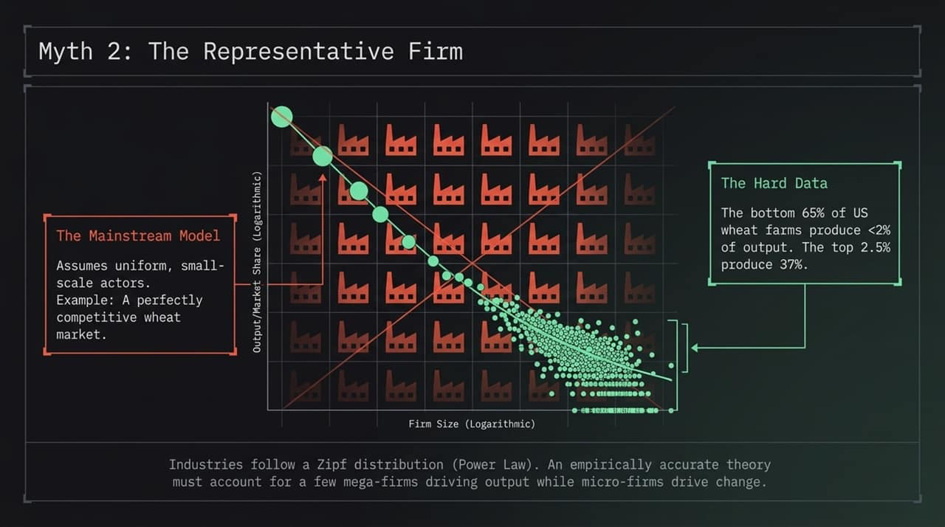
Notes:
Myth Number Two is The Representative Firm. To simplify their equations, mainstream models invent an 'average' or representative firm to represent an entire industry.
However, real-world industries do not follow normal distribution curves around a neat average; they follow Power Laws.
Take US agriculture—an industry often cited as a textbook example of perfect competition. The hard data shows that the bottom 65% of US wheat farms account for less than 2% of total output, while the top 2.5% of giant agribusinesses produce 37% of output.
When an economic policy assumes all firms act like the average player, it completely misses how market power, concentration, and outsized innovators shape macroeconomic outcomes.

Slide 6

Notes:
Perhaps the most dangerous misconception in mainstream policy is Myth 3: Banks are Just Middlemen.
Textbooks teach the 'Loanable Funds' model, portraying banks as passive intermediaries that take money from savers and lend it out to borrowers. Under this view, banks cannot create money; they just move existing money around.
The operational reality—validated by central banks like the Bank of England and the Federal Reserve—is Endogenous Money. Banks do not lend out existing deposits. When a bank issues a loan, it simultaneously creates a brand new deposit in the borrower's account out of thin air.
Loans create deposits, not the other way around. Commercial banks actively expand the money supply and drive purchasing power whenever they extend credit.

Slide 7
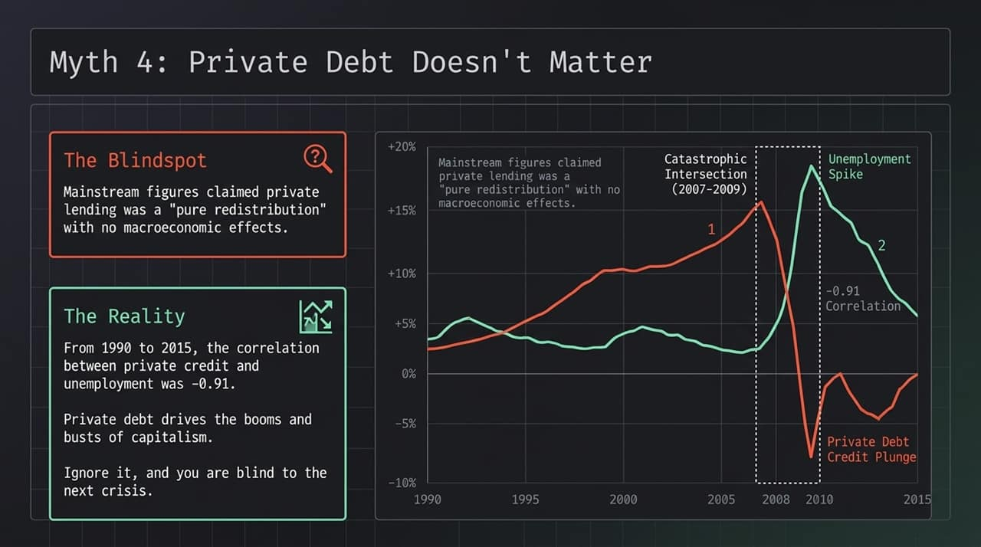
Notes:
Because mainstream models treated private debt as a 'pure redistribution' between savers and borrowers with no net impact on aggregate demand, they ignored private debt entirely. That is why almost no mainstream model foresaw the 2008 financial crisis.
Look at the data on this slide from 1990 to 2015. There is a striking -0.91 correlation between private debt credit expansion and the unemployment rate.
During the 2007–2009 crisis, as private credit plunged, unemployment spiked instantly. Private credit creation is the primary driver of financial booms and busts. If your model ignores private debt, you are navigating blind right before the next financial cliff.

Slide 8
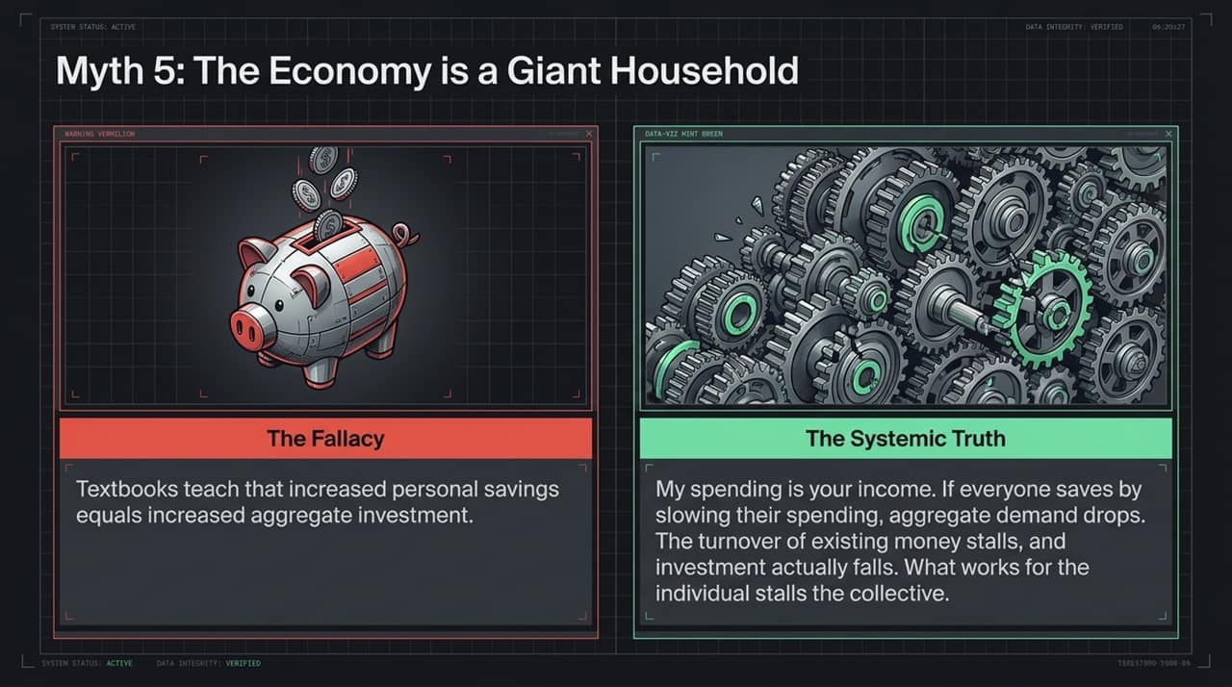
Notes:
Myth Number Five is the belief that The Economy is a Giant Household.
Politicians and textbook authors love to say, 'Just as a household must cut spending and save money during tough times, so must the national economy.'
Standard models teach that if individuals increase their personal savings rate, those savings directly translate into higher aggregate investment. But applying household-level micro logic to macro systems leads directly to the Fallacy of Composition.

Slide 9
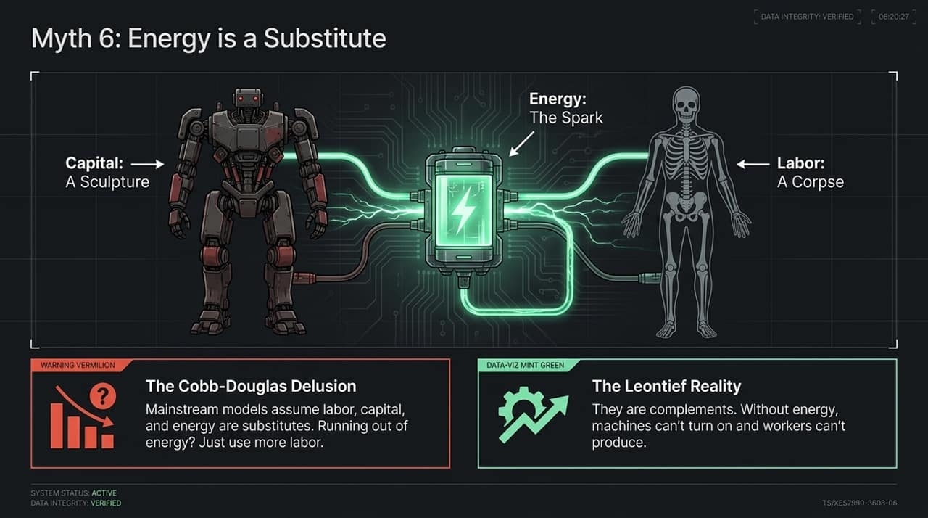
Notes:
Here is The Systemic Truth: My spending is your income, and your spending is my income.
If every household simultaneously attempts to save more by cutting back on spending, total aggregate demand in the economy collapses. As sales drop, businesses suffer losses, lay off workers, and cancel investment projects.
What works for a single individual in isolation actively damages the collective economy when done by everyone at once. The turnover velocity of money stalls, causing overall investment to fall rather than rise.

Slide 10
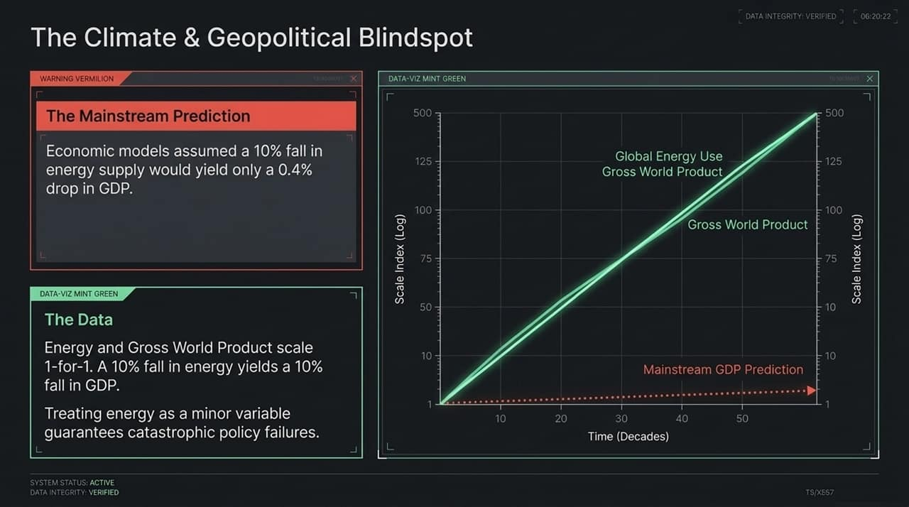
Notes:
Myth Number Six touches on the physical reality of production: Energy is Treated as a Simple Substitute.
Standard neoclassical models use production functions (like Cobb-Douglas) that treat labor, capital, and energy as interchangeable substitutes. In these equations, if energy becomes scarce or expensive, you can simply substitute it with more capital or labor.
This is a profound physical delusion. As illustrated here, without energy:
Capital is just an inert sculpture.
Labor without energy is a corpse.
Energy is not a minor input that can be swapped out; it is the fundamental spark that animates work. Labor, capital, and energy are structural complements.

Slide 11
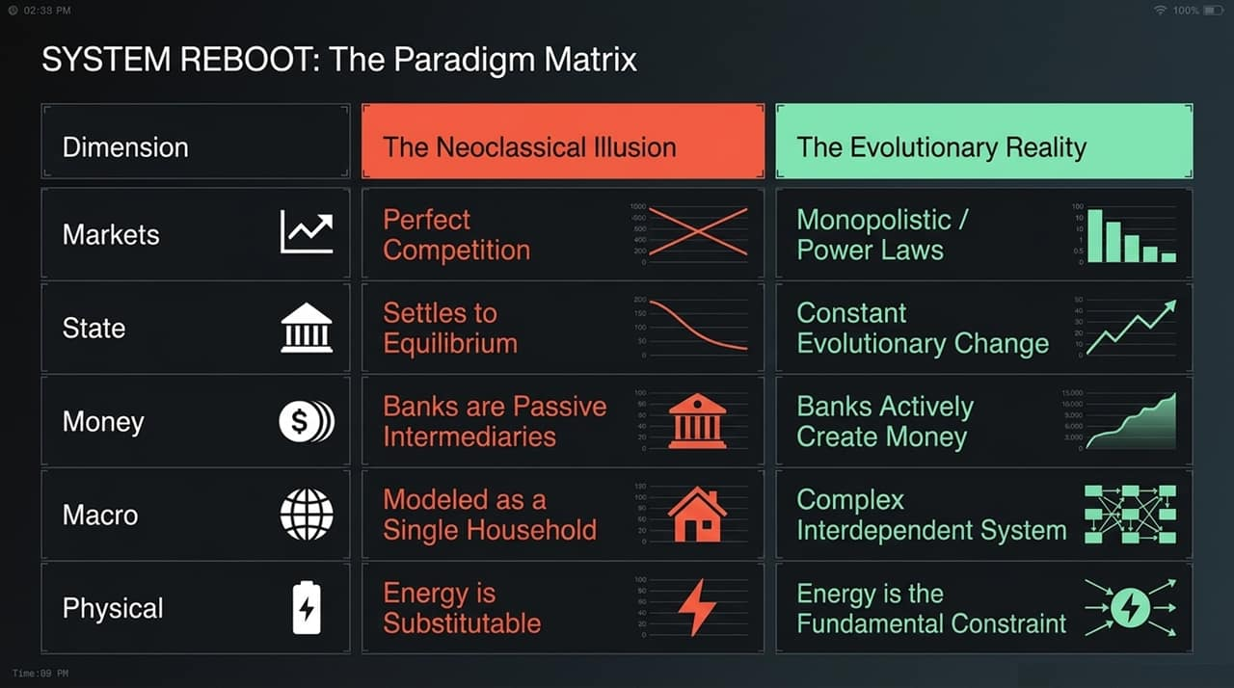
Notes:
This energy blindspot leads to catastrophic real-world policy predictions.
Because mainstream models assign energy a tiny cost-share weight in their equations, theoretical models predicted that a 10% drop in energy supply would cause only a tiny 0.4% drop in GDP.
Now look at the empirical data on the right. Gross World Product and Global Energy Use scale almost exactly 1-for-1. In the physical world, a 10% reduction in available useful energy causes approximately a 10% drop in GDP.
Treating energy constraints as trivial variables causes economists to severely underestimate geopolitical shocks and climate policy impacts.

Slide 12
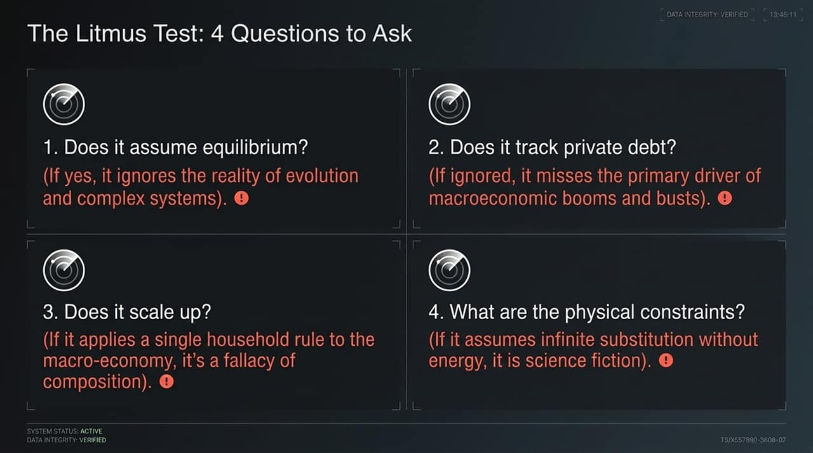
Notes:
To synthesize what we've covered, let's review The Paradigm Matrix comparing the Neoclassical Illusion against Evolutionary Reality:
Markets: Neoclassical models assume Perfect Competition. Reality shows Monopolistic Power Laws.
System State: Textbooks assume an economy settles into Equilibrium. Reality exhibits Constant Evolutionary Change.
Money: Models view banks as passive intermediaries. Reality shows banks actively create money.
Macro: Textbooks model the economy like a single household. Reality is an interdependent complex system.
Physical Rules: Standard theory treats energy as substitutable. Physical reality proves energy is the ultimate constraint.

Slide 13
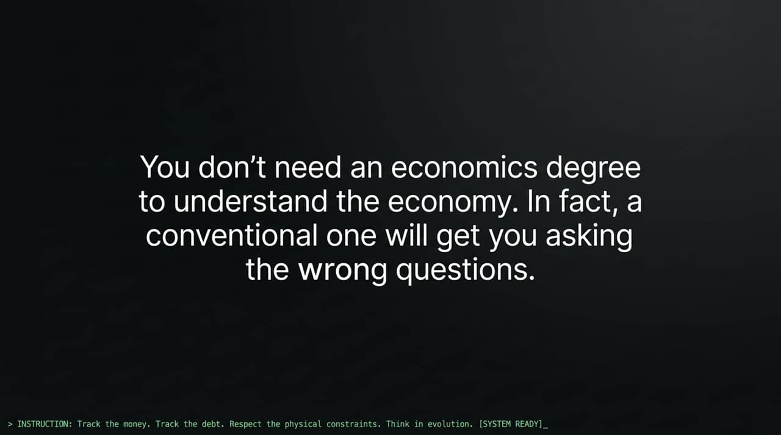
Notes:
Whenever you evaluate an economic proposal, market forecast, or policy paper, apply this 4-Question Litmus Test:
Does it assume equilibrium? If yes, it ignores complex systems and structural evolution.
Does it track private debt? If ignored, it is blind to credit cycles and financial fragility.
Does it scale up correctly? If it applies household savings rules to macro economies, it suffers from the fallacy of composition.
What are the physical constraints? If it assumes infinite output growth without accounting for energy inputs, it is fiction.

Slide 14
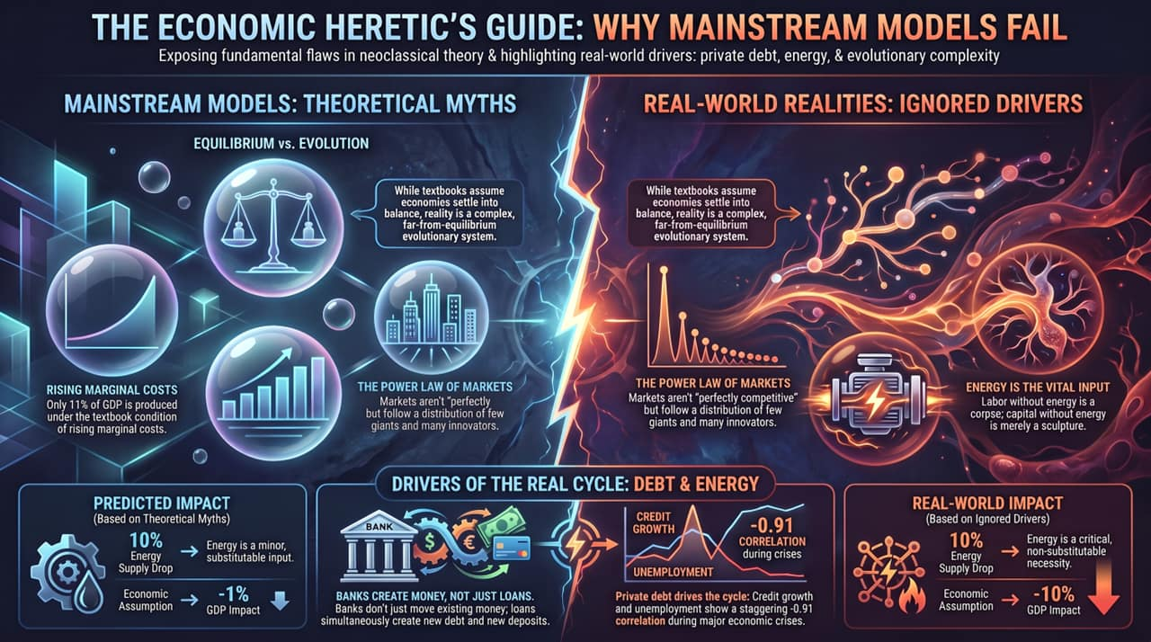
Notes:
To wrap up our session, this executive summary maps out The Economic Heretic's Guide:
Theoretical Myths: We must abandon static equilibrium, rising marginal cost assumptions, and uniform firm models.
Real-World Drivers: Private debt expansion and endogenous bank money creation are the true engines of macroeconomic fluctuations.
Physical Realities: Energy and resource availability set the true boundary conditions for global output.
By tracking the money, tracking private debt, respecting energy limits, and thinking in evolutionary systems, we can finally understand how capitalism actually works. Thank you!
https://www.youtube.com/watch?v=M1odc6itzyk

